Slide 1
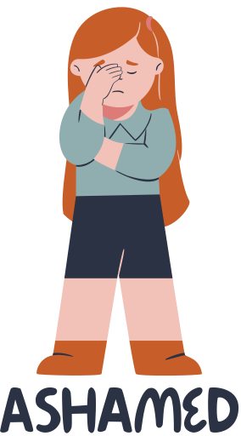

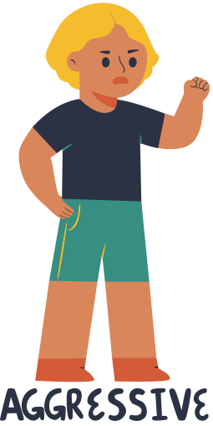




Feelings & Emotions

Slide 2

Let’s sing a song!
Instruction for Teachers: Click Enable Content => Enable Editing to play the video.

Slide 3

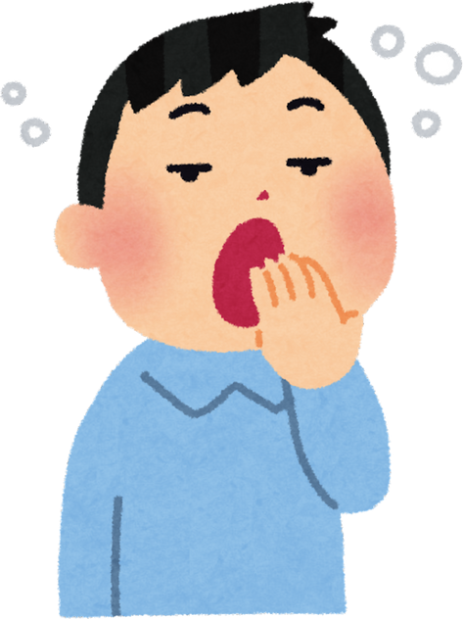

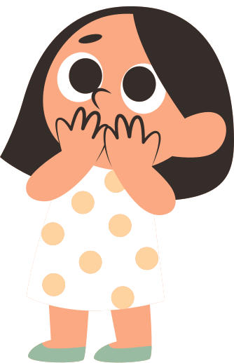
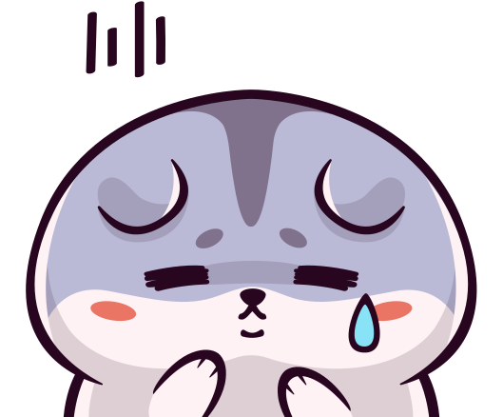
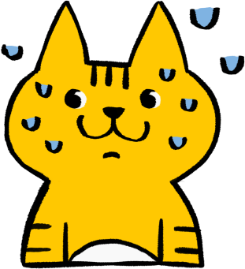

How are you today?
Happy
Sleepy
Angry
Surprised
Excited
Sad
Nervous

Slide 4

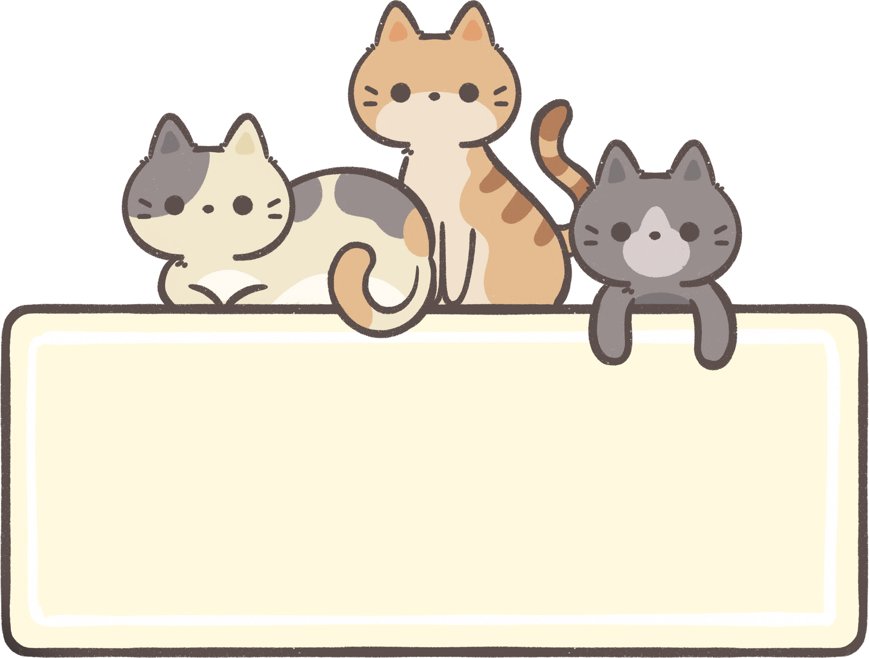




Page 1
Let’s learn more!

Slide 5
Ashamed

Slide 6
Jealous

Slide 7
Aggressive

Slide 8
Calm

Slide 9
Brave

Slide 10
Quiet

Slide 11

Energetic

Slide 12

Anxious

Slide 13

Mischievous

Slide 14
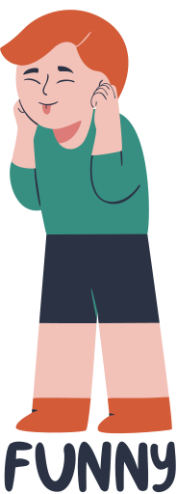
Funny

Slide 15








SPEAKING TIME

Slide 16




FEELINGS & EMOTIONS
Pretend you are very tired. What do you say?
Act like you are very excited. Why?
You see a monster! How do you feel?
Your friend gives you a gift. What do you feel?
You lose your toy. What do you feel?

Slide 17









FEELINGS & EMOTIONS
Ask your friend: “How do you feel today?”
Tell your partner one thing that makes you excited.
What makes you feel angry at school?
What can you do when someone feels sad?
When do you feel proud of yourself?

Slide 18
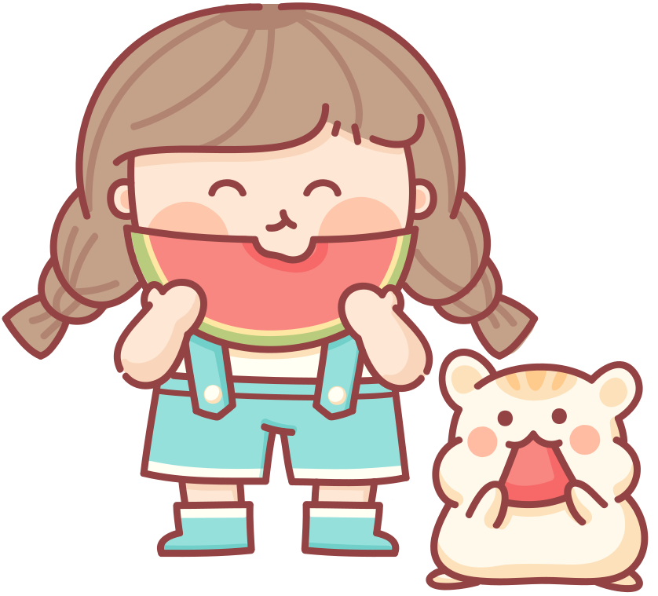




GAME – EMOTION CHARADES
How to play:
One student comes up and acts an emotion.
They act it out without speaking.
Others guess: “You are angry!” or “You feel sad!”

Slide 19



Review
Instruction for Teachers: Click Enable Content => Enable Editing to play the video.

Slide 20






THANK YOU!
SEE YOU
NEXT WEEK

